Slide 1


GROW
Personal Ministries
Training and Resources

Slide 2



Slide 3

Prepare the Soil
Build trust by showing love and kindness
Provide compassionate community service and health ministry

Slide 4

“The sowers of the seed have a work to do in preparing hearts to receive the gospel. . . . the love of Christ, revealed in personal ministry, may soften the stony heart, so that the seed of truth can take root.”
Christ’s Object Lessons, p. 57

Slide 5

Plant the Word
Engage in spiritual conversation or share testimony
Share truth-filled literature and media
Invite to church events

Slide 6

“The dissemination of the truth of God is not confined to a few ordained ministers. The truth is to be scattered by all who claim to be disciples of Christ.”
Christian Service, p. 68
Notes:
Witnessing not a spiritual gift

Slide 7

Cultivate Interest
Give ongoing Bible studies
Bring to small group Bible studies or evangelistic meetings

Slide 8



Slide 9
Church Social
Community Service
Cooking School
Concert
VBS

Slide 10
Church Social
Community Service
Cooking School
Concert
VBS
Baptized Disciple

Slide 11
Church Social
Community Service
Cooking School
Concert
VBS
Bible Studies
Baptized Disciple

Slide 12

“There are those in the world who are reading the Scriptures, but who cannot understand their import. The men and women who have a knowledge of God are needed to explain the word to these souls.”
Christian Service, p. 142
Notes:
Nehemiah 8:8

Slide 13

Harvest Decisions
Appeal for decisions in personal Bible studies
Appeal for decisions in public evangelistic meetings and other sermons

Slide 14

“If there is not a decided application of the truth to their hearts, if words are not spoken at the right moment, calling for decision from the weight of evidence already presented, the convicted ones

Slide 15
“pass on without identifying themselves with Christ, the golden opportunity passes, and they have not yielded, and they go farther and farther away from the truth, farther away from Jesus and never take their stand on the Lord’s side.”
Evangelism, p. 283

Slide 16

Preserve & Train
Provide systematic plan for discipleship of new members
Train members in soul-winning service
Nurture members

Slide 17

“After individuals have been converted to the truth, they need to be looked after. ... These newly converted ones need nursing, watchful attention, help, and encouragement.”
Evangelism, p. 337

Slide 18
“When souls are converted, set them to work at once. And as they labor according to their ability, they will grow stronger.”
Evangelism, p. 355

Slide 19
The GROW Process
1. Prepare = Serve
2. Plant = Share
3. Cultivate = Study
4. Harvest = Appeal
5. Preserve = Mentor

Slide 20

PREPARE
Churchwide Community Need-based Ministries

Slide 21

PLANT
Active
Literature
and Media
Ministries

Slide 22

CULTIVATE
Vibrant
Bible
Study
Ministries

Slide 23

HARVEST
Regular
Public
Evangelism

Slide 24

PRESERVE
Systematic Discipleship Ministries

Slide 25

Foundational Ministries
for every local church
CHURCHWIDE Need-based Ministries
ACTIVE Literature & Media Ministry
VIBRANT Bible Study Ministry
REGULAR Evangelistic Meetings
SYSTEMATIC Discipleship Ministry

Slide 26
Local Church Growth Potential
Every
Church Has Different Strengths & Weaknesses

Slide 27
Local Church Growth Potential
We should evaluate the strength or weakness of each phase

Slide 28
Local Church Growth Potential
The key is to recognize
that every
phase of
soul-winning is essential

Slide 29
Local Church Growth Potential
We can’t just focus on one or two areas and neglect the others

Slide 30
Local Church Growth Potential
This results in a growth
bottleneck that limits church growth.

Slide 31
Local Church Growth Potential
We must
strengthen every phase, always aiming for…

Slide 32
Local Church Growth Potential
Total Member Involvement

Slide 33
Question: If every member was involved in some form of personal outreach service, would the church grow?

Slide 34
Question: If every member was involved in some form of personal outreach service, would the church grow?
Not necessarily.

Slide 35


Slide 36


Slide 37
Why isn’t my church growing?
Identifying “no grow” areas

Slide 38
Church A
Church A is very busy. It holds cooking seminars, VBS and evangelistic meetings every year. It also has an active community service center and a mentorship program for new members. Why is it not growing as much as it could?

Slide 39
GROW | Church A
Prepare | Health, VBS, Community Services
Plant | NO GROW!
Cultivate
Harvest | Evangelistic Meetings
Preserve | Mentorship Program
While holding many church events, Church A is weak in the vital aspect of personal witnessing through literature and consistent Bible studies. Without these, it will experience modest growth at best.

Slide 40
Church B
After a careful process of preparing, planting, and cultivating, Church B holds an evangelistic series each year and baptizes new members. Within two years, however, most of these have no involvement in the church or have left the church altogether. What can be done to help Church B?

Slide 41
GROW | Church B
Prepare | Felt-Needs Ministries
Plant | Literature Distribution
Cultivate | Bible Studies
Harvest | Evangelistic Meetings
Preserve | NO GROW!
Church B is making church members but falling short of making disciples. It needs an intentional plan to disciple new members into active and spiritually grounded laborers in God’s cause.

Slide 42
Church C
The members of Church C share literature and give Bible studies. They also have an intentional plan for mentoring new members, but very few interests actually become baptized members of the church. What can Church C do to grow?

Slide 43
GROW | Church C
Prepare | NO GROW!
Plant | Literature Distribution
Cultivate | Bible Studies
Harvest | NO GROW!
Preserve | Mentorship Program
Church C has failed to build trust by ministering to the health and other needs of the community. It also fails to capitalize on the power of public evangelistic meetings to harvest decisions for Christ, including baptism.

Slide 44
Assignment
Activity or Ministry | GROW Phase
Cooking School
Vacation Bible School
Food & Clothing Ministry
Evangelistic Meetings
Parenting Seminar
New Member Discipleship
Finance Seminar

Slide 45
Assignment
Activity or Ministry | GROW Phase
Cooking School | Prepare
Vacation Bible School
Food & Clothing Ministry
Evangelistic Meetings
Parenting Seminar
New Member Discipleship
Finance Seminar

Slide 46
Assignment
Activity or Ministry | GROW Phase
Cooking School | Prepare
Vacation Bible School | Prepare
Food & Clothing Ministry
Evangelistic Meetings
Parenting Seminar
New Member Discipleship
Finance Seminar

Slide 47
Assignment
Activity or Ministry | GROW Phase
Cooking School | Prepare
Vacation Bible School | Prepare
Food & Clothing Ministry | Prepare
Evangelistic Meetings
Parenting Seminar
New Member Discipleship
Finance Seminar

Slide 48
Assignment
Activity or Ministry | GROW Phase
Cooking School | Prepare
Vacation Bible School | Prepare
Food & Clothing Ministry | Prepare
Evangelistic Meetings | Harvest
Parenting Seminar
New Member Discipleship
Finance Seminar

Slide 49
Assignment
Activity or Ministry | GROW Phase
Cooking School | Prepare
Vacation Bible School | Prepare
Food & Clothing Ministry | Prepare
Evangelistic Meetings | Harvest
Parenting Seminar | Prepare
New Member Discipleship
Finance Seminar

Slide 50
Assignment
Activity or Ministry | GROW Phase
Cooking School | Prepare
Vacation Bible School | Prepare
Food & Clothing Ministry | Prepare
Evangelistic Meetings | Harvest
Parenting Seminar | Prepare
New Member Discipleship | Preserve
Finance Seminar

Slide 51
Assignment
Activity or Ministry | GROW Phase
Cooking School | Prepare
Vacation Bible School | Prepare
Food & Clothing Ministry | Prepare
Evangelistic Meetings | Harvest
Parenting Seminar | Prepare
New Member Discipleship | Preserve
Finance Seminar | Prepare

Slide 52
The Importance of
Personal Ministry

Slide 53
Early Church Growth
“Go into all the world and preach the gospel to every creature.”
Mark 16:15

Slide 54
Early Church Growth
“At that time a great persecution arose against the church which was at Jerusalem; and they were all scattered throughout the regions of Judea and Samaria, except the apostles.”
Acts 8:1

Slide 55
Early Church Growth
“Those who were scattered went everywhere preaching the Word.”
Acts 8:4

Slide 56
Early Church Growth
“I kept back nothing that was helpful, but proclaimed it to you, and taught you publicly and from house to house.”
Acts 20:20

Slide 57
Church or Personal?
“Your work may accomplish more real good than the more extensive meetings, if they lack in personal effort. When both are combined, with the blessing of God, a more perfect and thorough work may be wrought; but if we can have but one

Slide 58
Church or Personal?
“part done, let it be the individual labor of opening the Scriptures in households, making personal appeals, and talking familiarly with the members of the family, not about things of little importance, but of the great themes of redemption.”
Christian Service, p. 121

Slide 59





Slide 60
Equipping the Saints
Local church ministries should be developed that encourage, train, and equip members for personal ministry.

Slide 61
Church Ministries
equip for personal ministries
CHURCHWIDE Need-based Ministries
ACTIVE Literature & Media Ministry
VIBRANT Bible Study Ministry
REGULAR Evangelistic Meetings
SYSTEMATIC Discipleship Ministry

Slide 62
The Training School
“Every church should be a training school for Christian workers.”
Christian Service, p. 59

Slide 63
The Training School
The primary focus of local church ministries is not to win souls…

Slide 64
The Training School
The primary focus of local church ministries is not to win souls…
but to train and equip members to win souls.

Slide 65
The Role of Ministers
“Ministers, preach the truths that will lead to personal labor for those who are out of Christ. Encourage personal effort in every possible way.”
Christian Service, p. 69

Slide 66
The Role of Ministers
“In every church the members should be so trained that they will devote time to the winning of souls to Christ. . . . Let those who have charge of the flock of Christ [pastors] awake to their duty, and set many souls to work.”
Christian Service, p. 61

Slide 67
The Role of Ministers
“Let ministers teach church members that in order to grow in spirituality, they must carry the burden that the Lord has laid upon them—the burden of leading souls into the truth.”
Christian Service, p. 69

Slide 68
Decentralization of Ministry
Local churches should always work toward the decentralization of ministry. This means that the primary role of pastors is to mentor, train, equip, and encourage personal ministry.

Slide 69
The Danger of Centralization
“Everywhere there is a tendency to substitute the work of organizations for individual effort [focus on church programs instead of personal ministry]. . . . Christ commits to His followers an individual work.”
The Ministry of Healing, p. 147

Slide 70
Back to Personal Ministries
“Those who were scattered [lay members of the church] went everywhere preaching the Word.”
Acts 8:4

Slide 71
Multiplying Disciples
“One soul, won to the truth, will be instrumental in winning others, and there will be an ever-increasing result of blessing and salvation.”
Christian Service, p. 121

Slide 73


GC SSPM
Our Goal

Slide 74

GC SSPM
New Strategic Resources

Slide 75
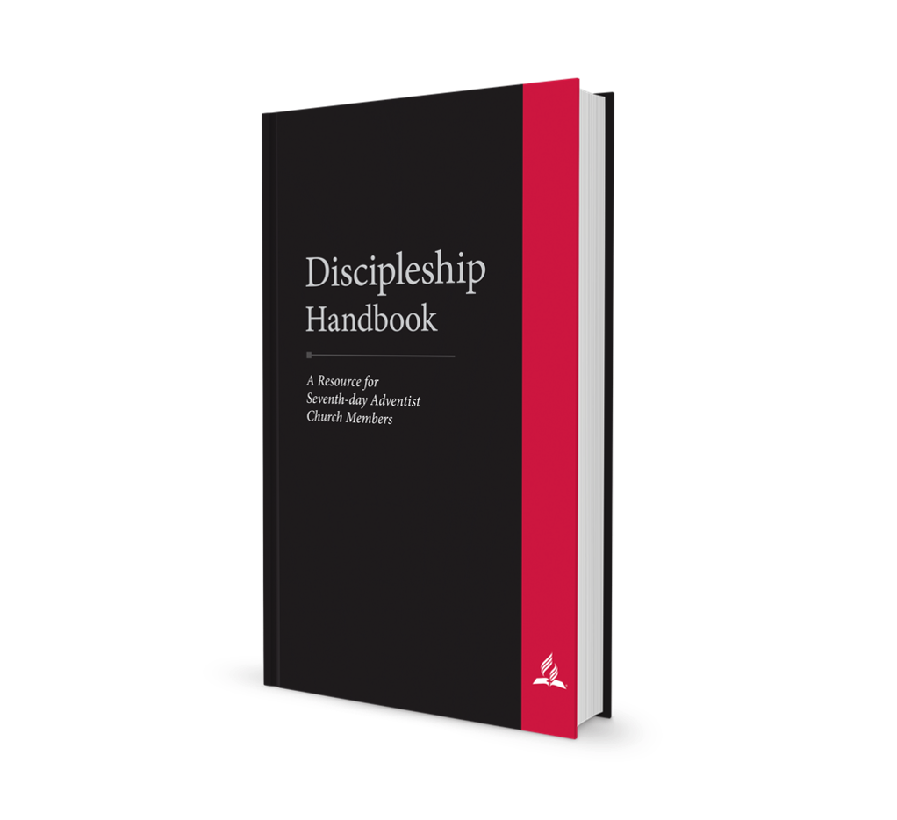
Discipleship Handbook:
A Resource for
Seventh-day Adventist
Church Members

Slide 76
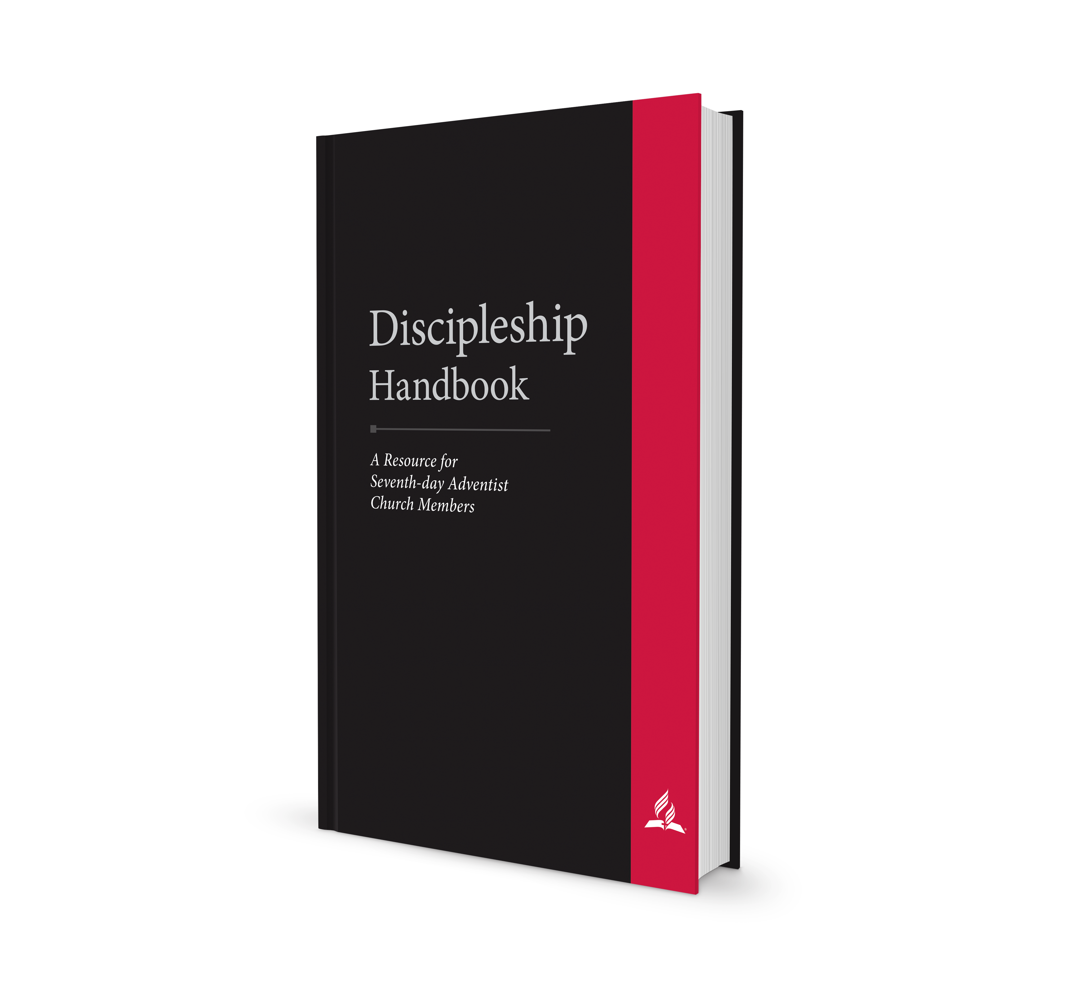
A book to be used in discipleship rather than a book about discipleship
Practice, not Theory

Slide 77
How to Use:
Pair newly baptized or less experienced members with those of more experience (mentors)

Slide 78
How to Use:
Meet weekly to review one chapter together

Slide 79
How to Use:
Mentors follow weekly outlines (in Appendix A) that recommend various activities to integrate new members

Slide 80
How to Use:
In week two, new member begins reading plan (in Appendix B—provide access to SOP books)

Slide 81
How to Use:
Pastor or discipleship ministry leader meets or talks to mentors at least monthly to provide support and accountability

Slide 82
overview:
Discipleship
Bible
Spirit of Prophecy
Prayer
Character

Slide 83
overview:
Family Worship
Identity and Mission of Remnant Church
Witnessing
Church Attendance
Church Ordinances

Slide 84
overview:
Church Organization
Adventist History
Adventist Ministries
Christian Lifestyle
Sabbath Observance

Slide 85
overview:
Reverence
Stewardship
Health
Modesty
Entertainment

Slide 86
overview:
Marriage and Family
Evangelism Cycle
Prepare the Soil
Planting the Seed
Cultivating Interest
Harvest and Preserve

Slide 87
overview:
A. The Discipleship Plan with Weekly Meeting Outlines for Mentors
B. Bible and SOP Reading Plan

Slide 88

Fundamentals of Faith:
A Summary of
Essential Bible
Doctrines

Slide 89

Fundamentals of Faith: Baptism & POF Preparation

Slide 90
Covers all 28 fundamental beliefs

Slide 91
Includes “My Commitment” points for decisions

Slide 92
Church members can prepare candidates for baptism

Slide 93

Spread the
Word:
A Guide to Personal
Witnessing Through
Conversation,
Literature, Media,
and Other
Seed-Sowing
Activities

Slide 94

Power for Witnessing
Christlike Character
Taking the Initiative
Spiritual Conversations
Sharing Your Testimony
Giving Invitations
Sharing literature
Sharing Media
Organizing Group
Outreach

Slide 95
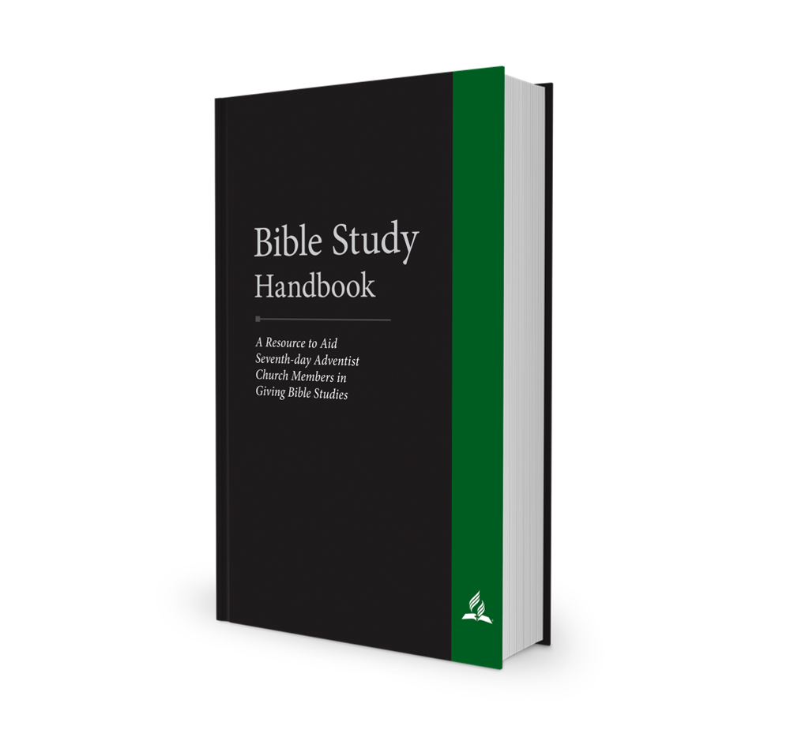
Bible Study
Handbook:
COMING
SOON!
A Resource to Aid
Seventh-day Adventist
Church Members
in Giving Bible
Studies
COMING
SOON!

Slide 96
Inspiration and Basics
The heart of evangelism
A method for members
Christ at the center
The power of prophecy
How to give Bible studies

Slide 97
Topical Training
26 chapters/topics
3-4 key points in each study
Most persuasive texts with clear explanations
Sample appeal
Christ at the center
Prophetic link
Common questions

Slide 98
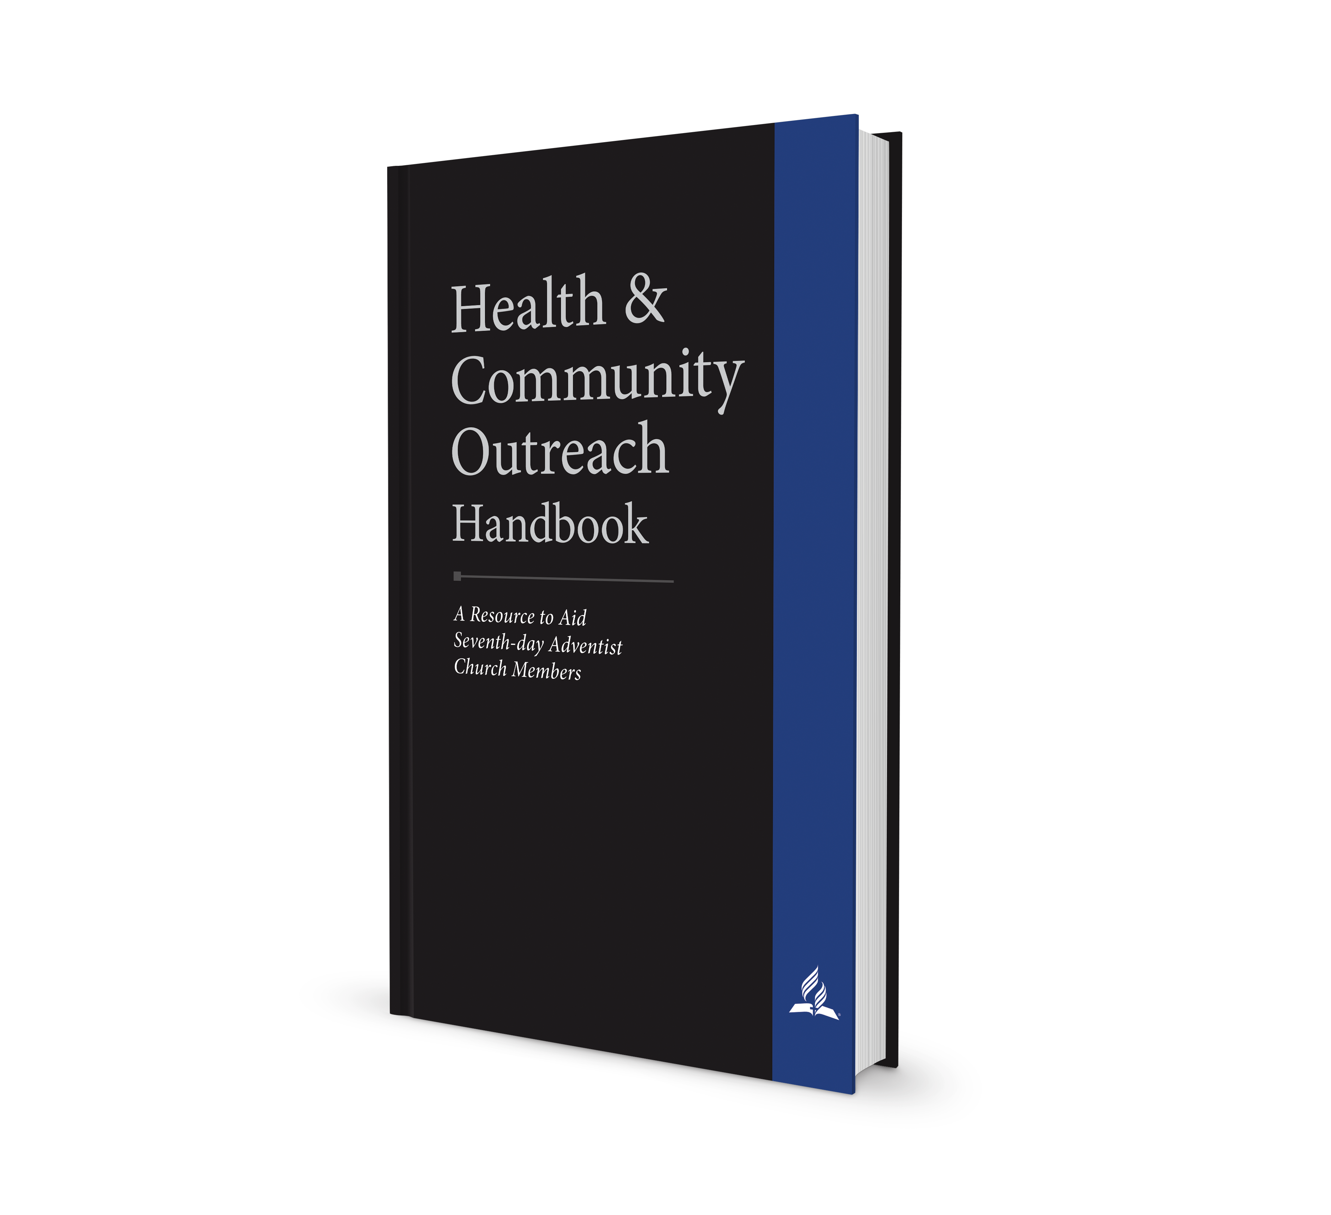
Health Ministry
Handbook:
COMING
SOON!
Health Ministry Handbook
A Practical Guide to Aid Churches in Conducting Effective Health Ministries
COMING
SOON!

Slide 99
Community
Outreach
Handbook:
COMING
SOON!
Community
Outreach
Handbook
A Practical Guide to
Aid Churches in
Providing
Compassionate
Need-based
Ministries
COMING
SOON!

Slide 100


Slide 101
grow.adventist.org

